Slide 1
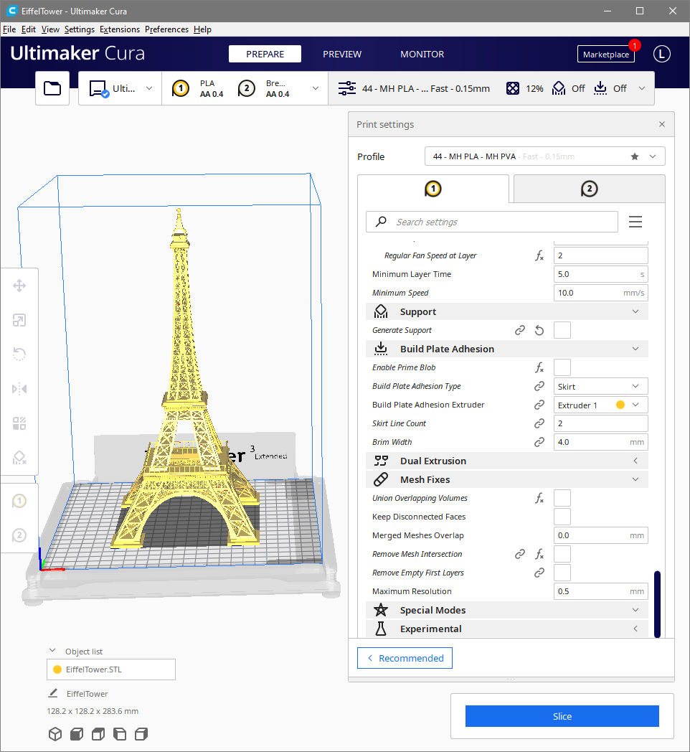
Ultimaker Cura
Profile and User Interface Improvements
Presented by
Lance A. Endres, Ph.D.

Slide 2
Please feel free to interrupt, ask questions, or have me repeat something that is unclear.
Ultimaker Cura Profile Discussion
Notes:
To To bring user-friendly desktop pickTo bring user-friendly desktop pick-and-place technology to the maker community.-and-place technology to the maker community.brTo bring user-friendly desktop pick-and-place technology to the maker community.inTo bring user-friendly desktop pick-and-place technology to the maker community.g user-friendly desktop pick-and-place technology to the maker community.To bring user-friendly desktop pick-and-place technology to the maker community.

Slide 3
Notes:
I’m not trying to claim I have all the answers. My point is, I’m not some from the internet with uninformed opinions. I have a background doing exactly these types of things and I have put significant thought into how I would write the software to solve these problems.

Slide 4
Notes:
I’m not trying to claim I have all the answers. My point is, I’m not some internet yahoo popping off about something he has no understanding of. I have a background doing exactly these types of things and I have put significant thought into how I would write the software to solve these problems.

Slide 5
Problem Statement
Profiles are extremely difficult to work with.
Notes:
The problem we are trying to solve.

Slide 6
Profile Problems
There are 3 main issues with profiles.
Profiles are extremely difficult to maintain.
The user interface is organized poorly.
The user interface needs more space to work with profiles.

Slide 7
Profile Problems
Given the large number of settings and way profiles are defined, maintaining profiles very rapidly becomes a logistical impossibility.
Profile and settings count explosion.
It is not feasible to maintain profiles for each type of printing scenario.

Slide 8
Profile Difficulties
Profiles contain a very large number of settings.
Changing a single settings results in a new profile.
This causes the total number of stores settings to multiply very rapidly.
Profiles need to be more “reusable” and flexible.
The user interface is organized poorly.

Slide 9
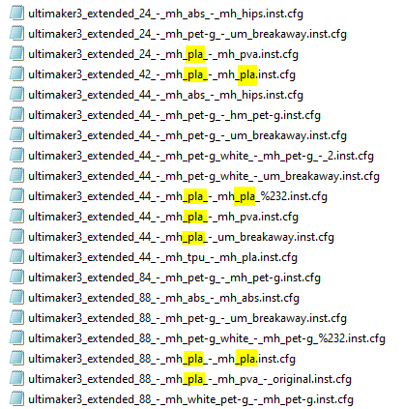

Slide 10
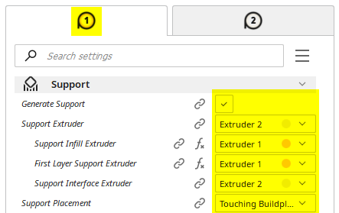
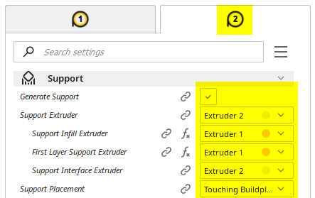
Problems
Duplication of controls on User Interface
2 controls for 1 setting is red flag there is a design issue
Users find it confusing that settings are linked
Non-standard/unique approaches are best avoided

Slide 12
Profile Demonstration Software
A basic example to demonstrate concepts.
A minimum number of settings are incorporated.
Data validation is not complete.
Not intended as “the” solution.
There are many possible valid implementations.
Please focus only on the concepts and learnings.
Take away the Big Picture.

Slide 13
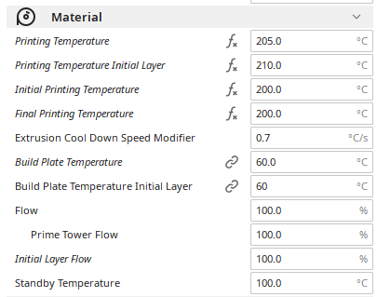
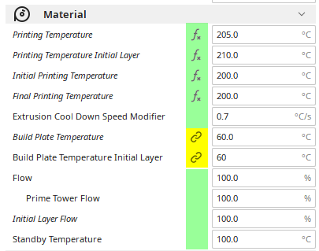
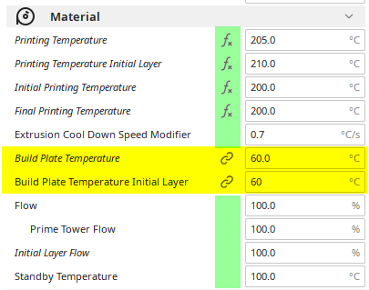
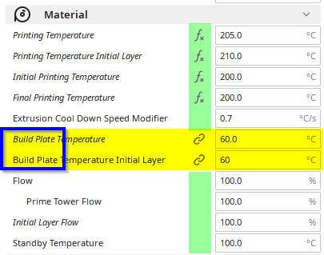
Some Settings Need Moving
Some settings are categorized incorrectly.
They are typically easy to identify.
Categorizing them correctly is typically easy, as well.

Slide 14
Organization Changes
This section contains some specific examples of suggested changes.
Notes:
The problem we are trying to solve.

Slide 15
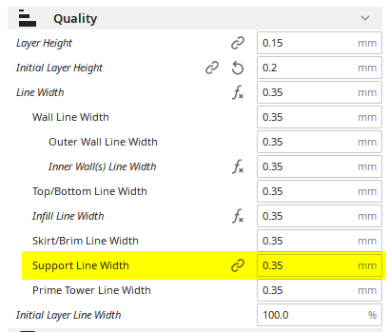
Support Line Width
Support Line Width is the only one of these settings that is “linked” and that is an indication something is wrong.
In this case, the setting is organized in the right place, but its behavior is wrong.
Line widths are more closely associated with nozzle size (extruder).
Each extruder needs its own Support Line Width.

Slide 16
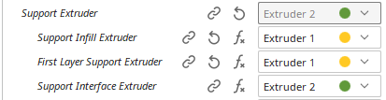
Support Line Width
1
OR
Imagine the case where there is one 0.4 mm nozzle and one 0.8 mm nozzle size loaded.
You have to first select which nozzle is used for support, then go back and set the support line width. This is awkward and unnecessary.
How is case of support interface versus support infill handled? One of the nozzles is going to be printing with the wrong Support Line Width for its size.
2

Slide 17
Key Take Aways
“Linked” Settings
“Linked” settings need to be removed from the “extruder” tabs and into their own sections.
Each “linked” setting should be evaluated to determined its proper section.
Profiles
Profiles need to be more reusable.
Recommend making each section its own “mini profile.”
User Interface
More room is needed to edit settings. Much more room.

Slide 18
Conclusions
Changes would make the user interface easier to use, cut down on redundancy, and be more logical.
Profiles would be a lot easier to use.
Cut down on profile proliferation.
Less editing of profiles to customize them for each print.
Prepare Cura for the future.
More extruders are inevitable. Without these changes the problems will only multiply.

Slide 19

Mission statement
To bring user-friendly desktop pick-and-place technology to the maker community.

